Slide 1


Molecular Layer Deposition of a thin film for the formation of a hybrid protein / solid state nanopore
Jay Werner, UW Chemical Engineering (they/them)

Slide 2
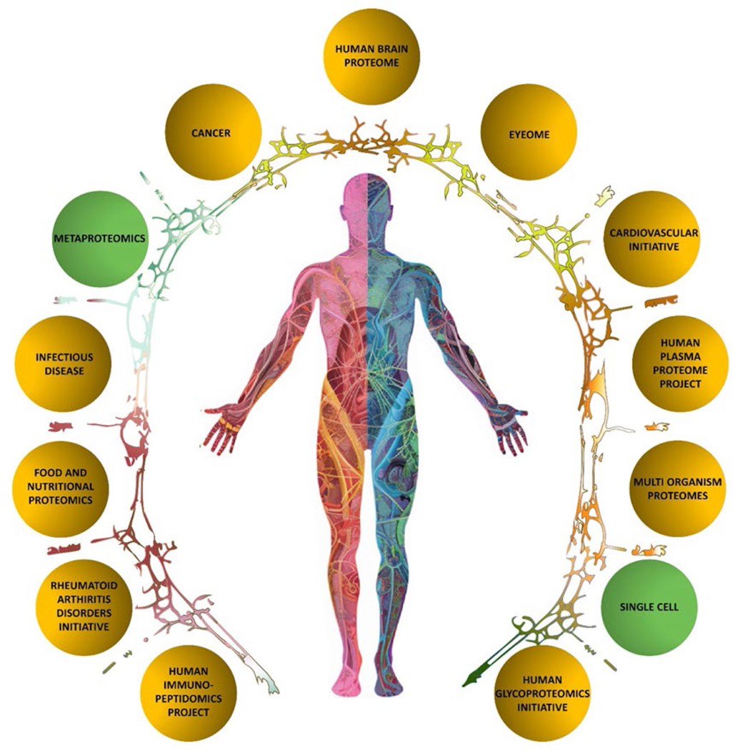
Diagnostic protein sensing
(Omenn et al., 2024)¹
2
Notes:
Proteomics: the global composition and inter-relationships of the proteins in an organism
Diagnostics: the specific presence and concentration of pre-determined relevant proteins
Mass spectrometry:
Sensitive, label free, high throughput
Expensive, complex, “slow”
Immunoassays
Cheap, fast, simple
Slow pipeline of development, prone to cross reactivity

Slide 3
DNA sequencing is also important

Slide 4
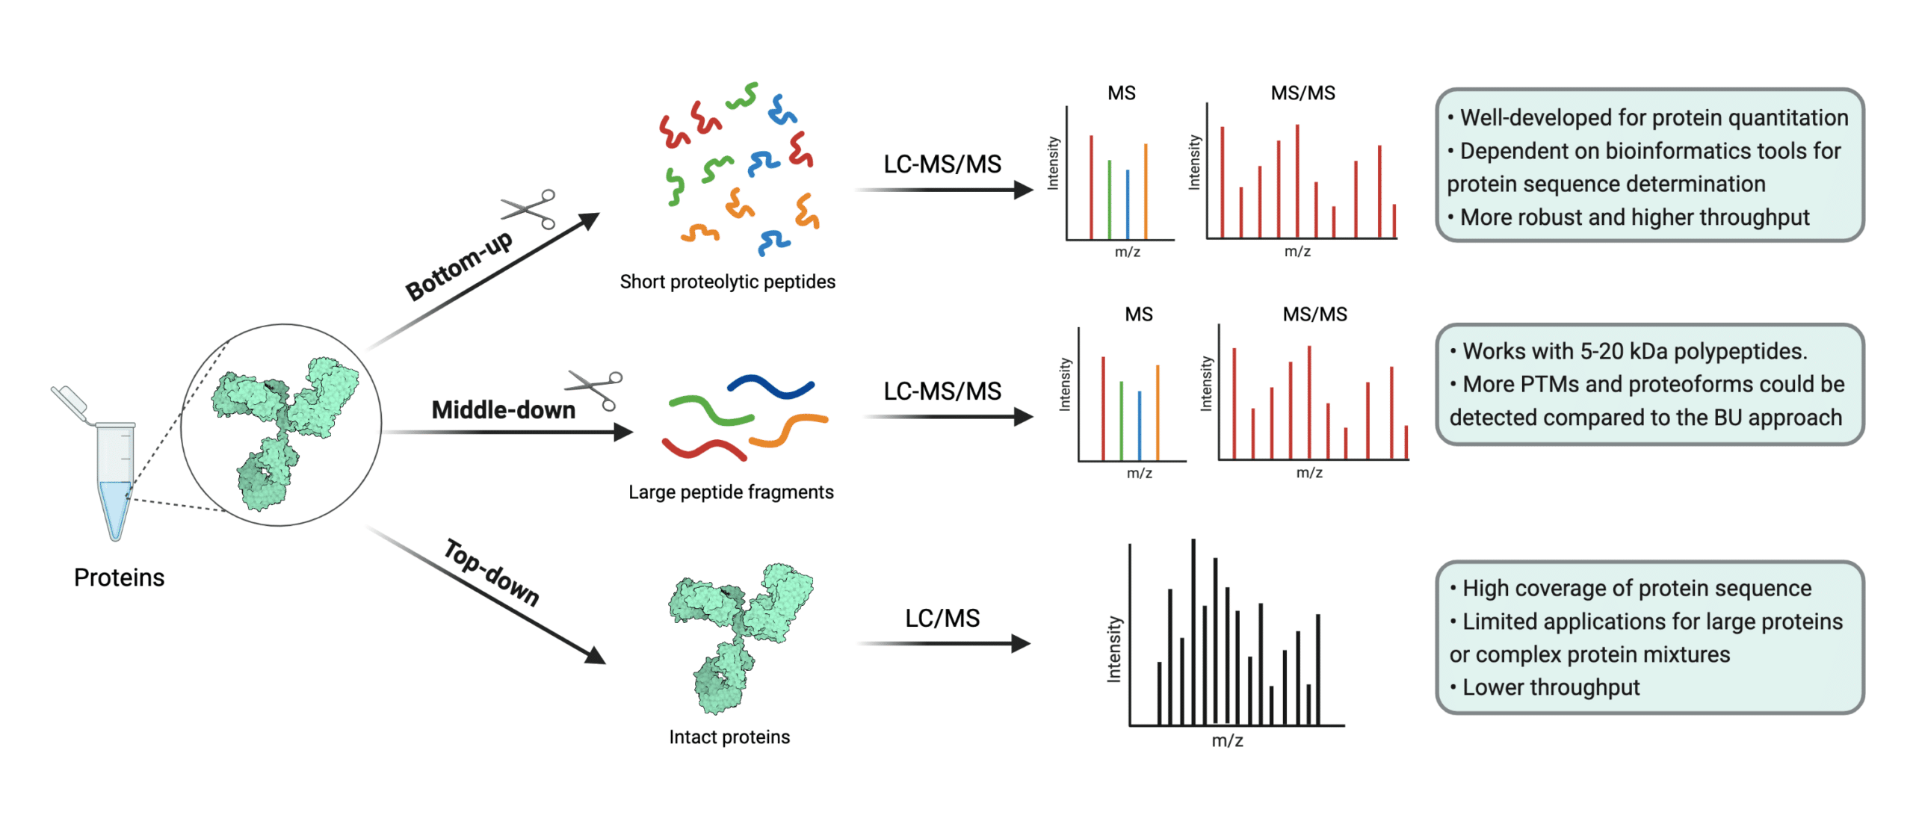
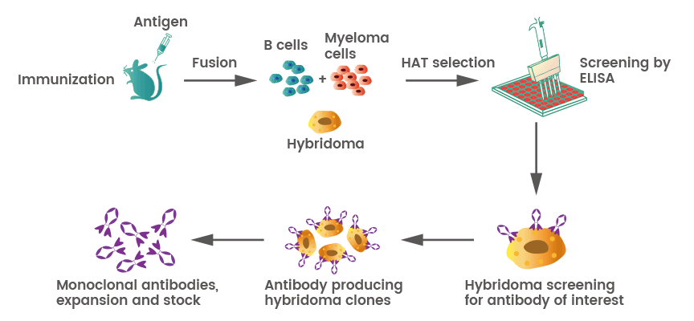
Critical tools for protein detection
Mass spectrometry
  (+) Highly sensitive
  (+) Label free
  (+) High throughput
  (-) Expensive
  (-) Complex
  (-) Relatively slow in a diagnostic setting
Immunoassays
  (+) Cheap
  (+) Fast
  (+) Simple
  (-) Requires slow development of antibodies/antigens prior to use
  (-) Prone to confounding cross-reactivity
https://www.rapidnovor.com/what-is-protein-mass-spectrometry/
https://www.mblbio.com/bio/g/support/method/elisa.html
https://www.sinobiological.com/resource/antibody-technical/antibody-production
4
4
Notes:
As such, the fields of proteomics and diagnostic testing utilize different critical tools for protein detection.
Mass spectrometry is indispensable to the proteomics researcher because it can detect any known, or unknown, protein without any reconfiguration. Proteomics is concerned with any of the hundreds of millions of possible proteins present in a sample, often with the need to measure multiple analytes from a mixture simultaneously. Mass spectrometry is:
Highly sensitive, capable of sensing extremely small numbers of proteins without special purification
Label free and high throughput, capable of sensing any number of unknown unknowns in a continuous fashion
However, mass spectrometry is also:
Extremely complex and expensive
Relatively slow in a diagnostic setting, takings hours to days to analyze a sample
Meanwhile, diagnostic protein sensing has settled with immunoassay detection as the tool of choice, restricting itself to the sensing of a relatively limited number of predetermined target proteins. Immunoassay detection is:
Cheap, fast, and simple, capable of delivering presence and concentration information about target proteins in minutes with little to no variation in the testing method or analysis between targets
However, immunoassays:
Require lengthy preparation of antibodies or antigens prior to use, relying upon the immune response of live mammalian test subject to generate the key component of the assay
Are prone to confounding cross reactivity which is impossible to detect or completely unknown
Clearly, there is something to be desired in the ability to detect any target protein on demand and without confounding cross reactivity. Efforts have been made to make mass spectrometers available to diagnosticians for this purpose, but the equipment and expertise are simply prohibitive barriers to entry for a diagnostics lab.

Slide 5
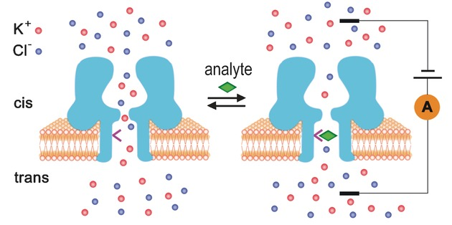
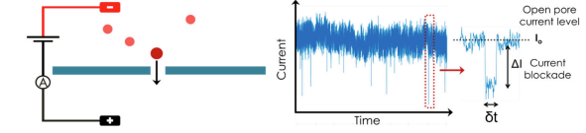
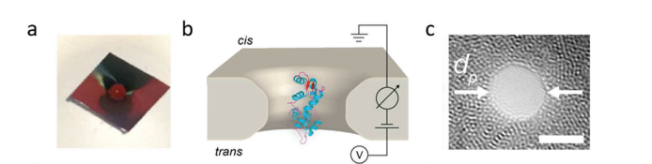
The middle road
Reynaud, 2020
Hu, 2020
5
Notes:
The cost and complexity of mass spectrometry prohibits its use in diagnostics laboratories
Immunoassays must be improved upon with a technique that can rapidly adapt to new targets and reduce the impact of cross reactivity
Nanopore sensing has this ability, and is potentially even cheaper, faster, and simpler
Based on the Coulter principle
Constructed from:
A protein in a lipid bilayer: (+) readily folds to ~1nm scale diameter, (+) resistant to clogging, (-) transient lipid bilayer membrane
A solid state material: (+) mass manufacturable, (+) durable membrane, (-) prone to clogging, (-) ~1nm milling is unreliable and >1nm diameter produces unintelligible data

Slide 6
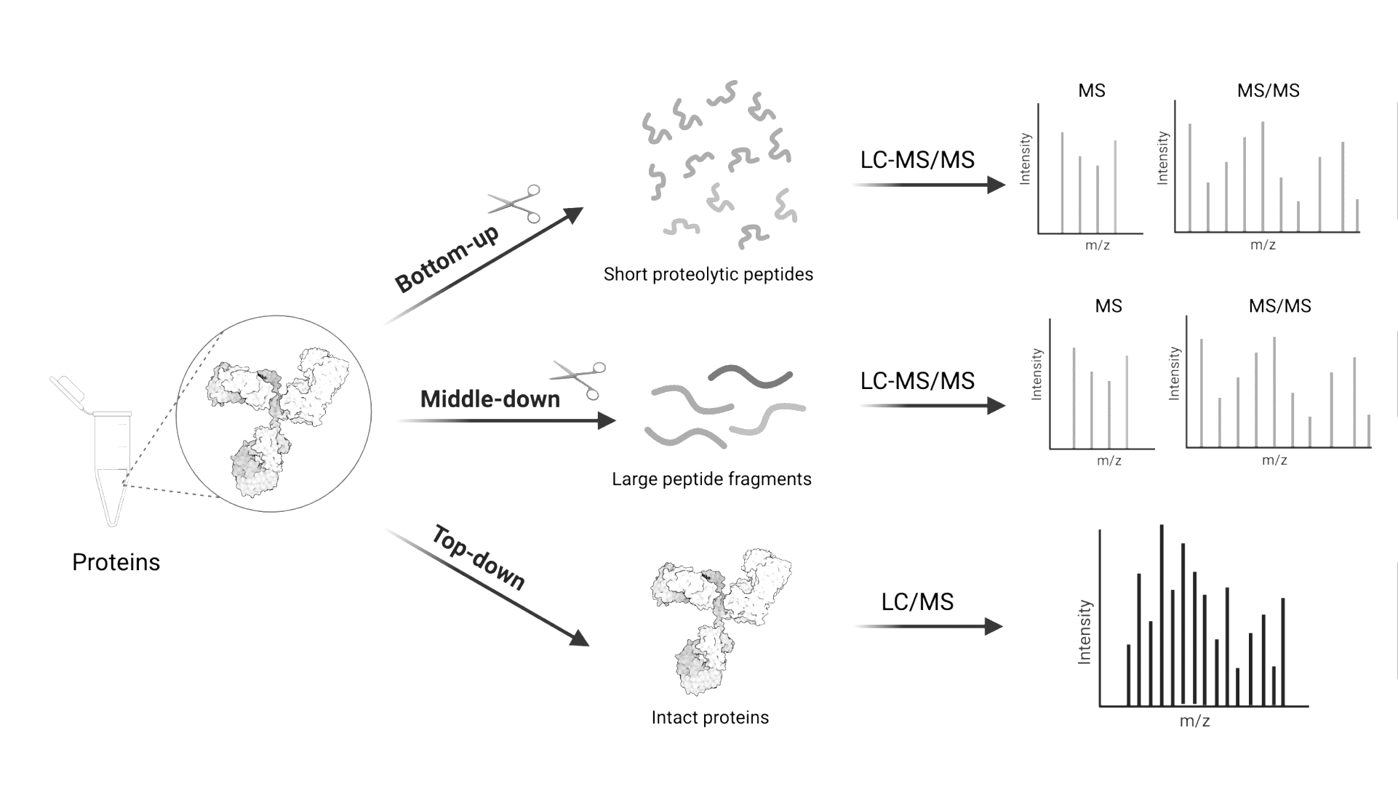
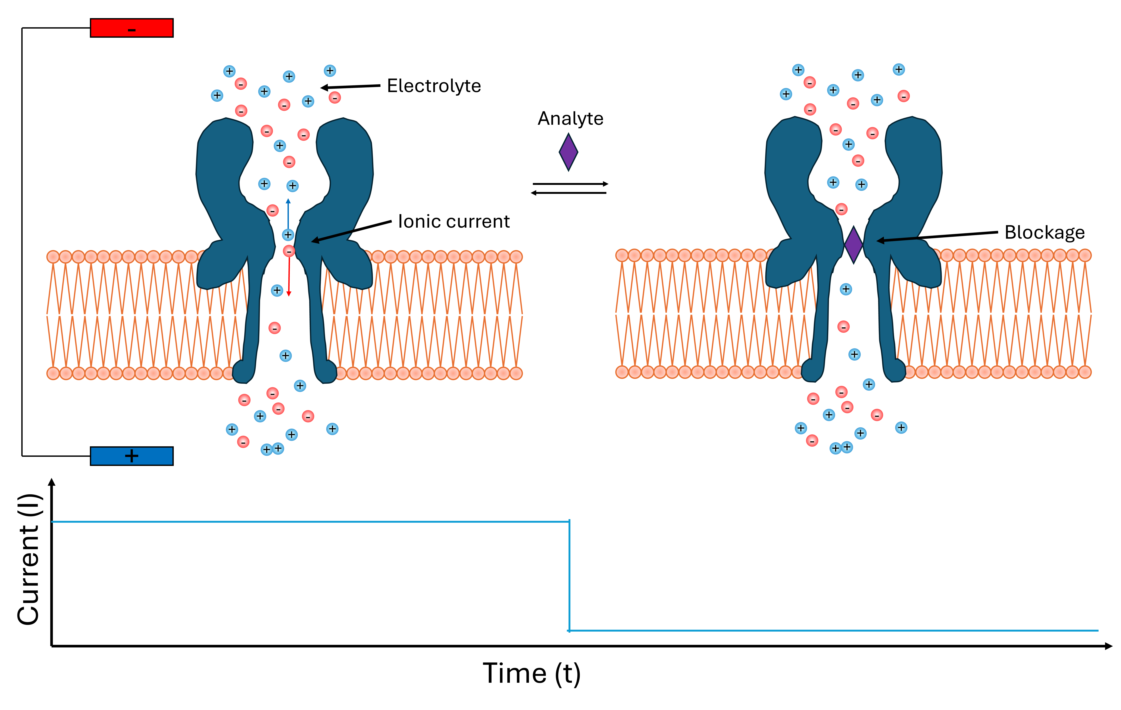
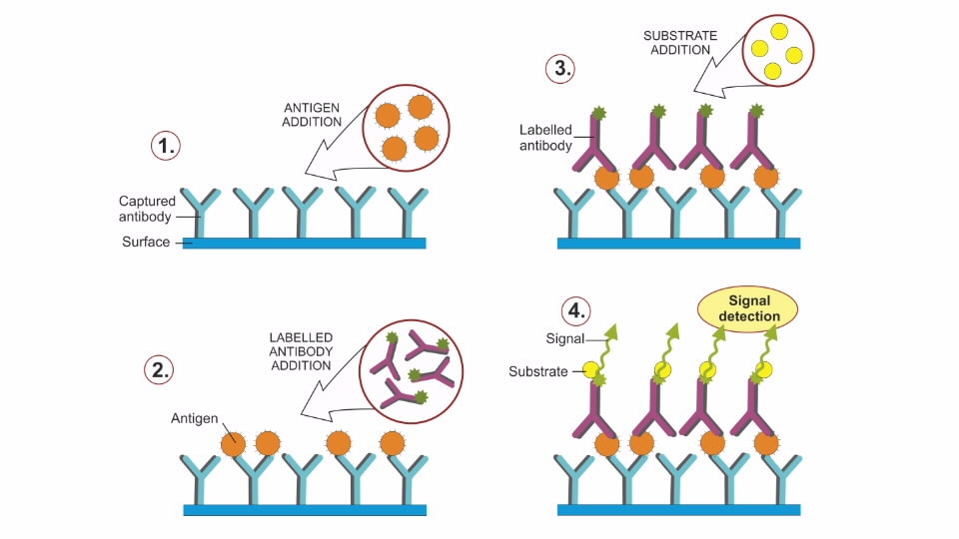
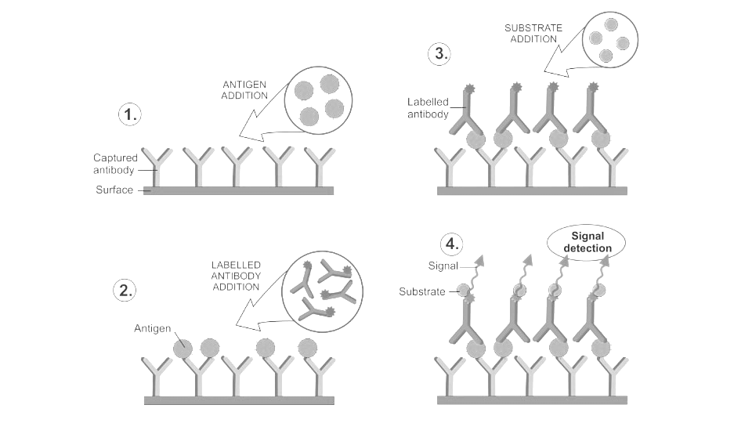
An unfilled protein sensing niche
Mass spectrometry
Mass spectrometry
Nanopore sensing
Intermediate?
(Gerpe, 2021)²
(Gerpe, 2021)²
Immunoassays
Open state
Δt
Immunoassays
ΔI
Current blockade
(Agilent Technologies, 2026)³
(Agilent Technologies, 2026)³
6

Slide 7
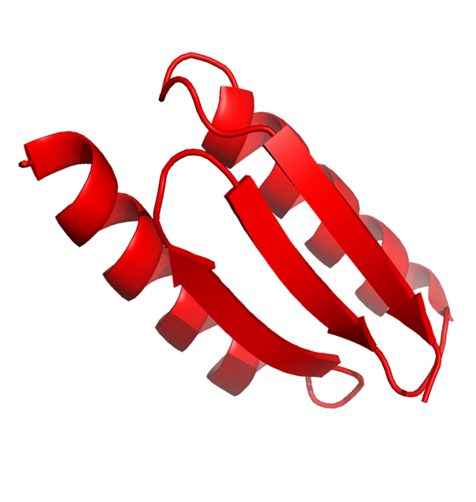

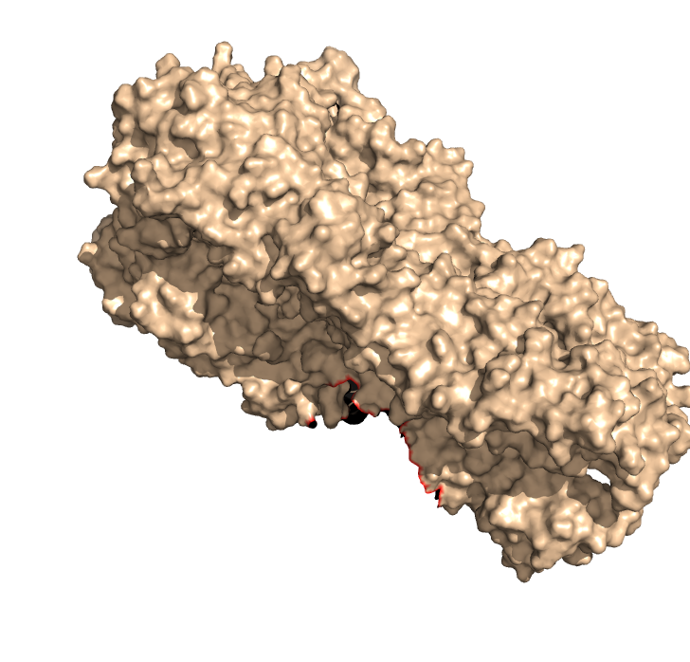
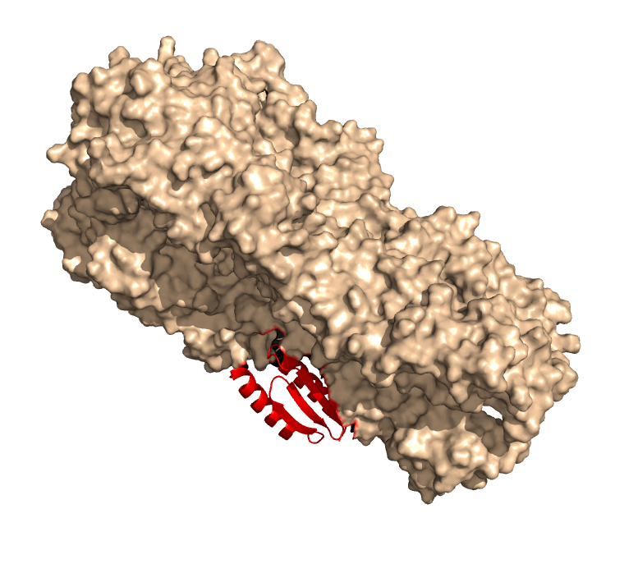
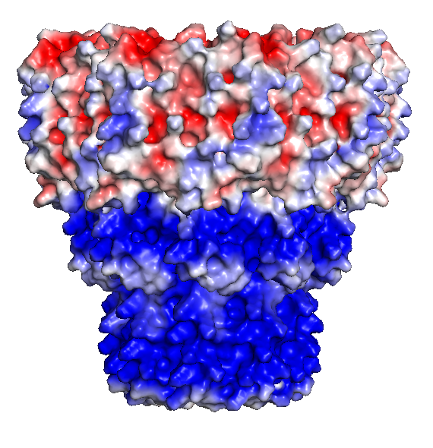
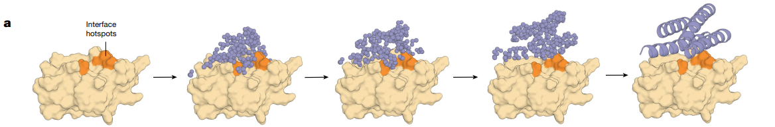
A modular nanopore protein sensing platform
RFdiffusion design of de novo nanopore
Open state
Current blockade
+
-
-
+
+
-
+
-
(Watson et al., 2023) [4]
+
-
-
Surface functionalization of solid state nanopores to form a hybrid nanopore structure
+
+
+
Design of de novo mini binders for target structure alone [4,5]
+
-
+
-
-
(Watson et al., 2023) [4]
7
Notes:
You may be familiar with nanopore DNA sequencing using naturally occurring, biological nanopores such as α-hemolysin, MspA, ClyA, and the phi29 motor protein (Luo 2020). This is a relatively mature technology, unlike nanopore protein sensing. DNA sequencing is a conceptually simpler task compared to protein sequencing or whole protein sensing. For starters, sequencing a protein requires the discrete detection of 20 amino acids compared to just 4 nucleobases. Moreover, whole protein sensing requires the ability to detect higher order structural features.
Our approach to protein sensing targets the structure of the protein, rather than it’s sequence

Slide 8
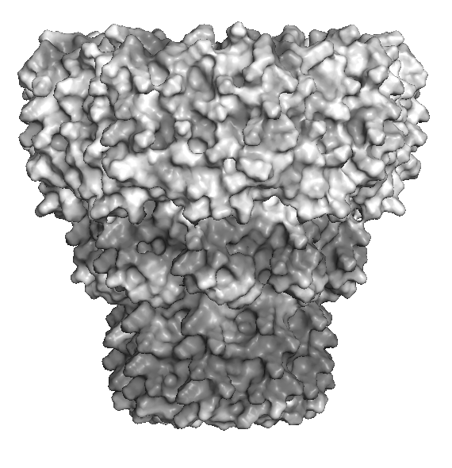
Electrokinetic corking
Electro-osmotic flow
(drag force)
Electrophoretic force
Electrostatic force
-
+
δ+
+
+
+
+
+
+
+
+
+
+
+
+
+
8

Slide 9
Slide explaining current traces, protein expression, and cryo em images

Slide 10
Evidence of transient electrokinetic corking
Current returns to open state
Potential is reversed
10
Notes:
Protein nanopores docked in solid state nanopores
Reversing potential uncorks protein nanopore
Need surface coating to facilitate durable bond with the surface

Slide 11
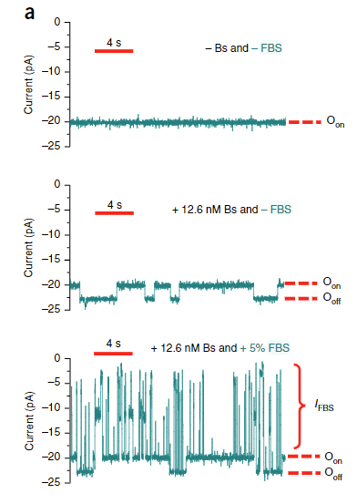
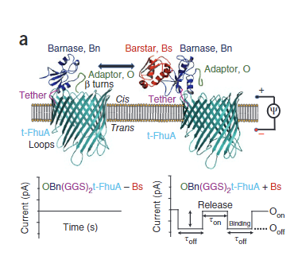
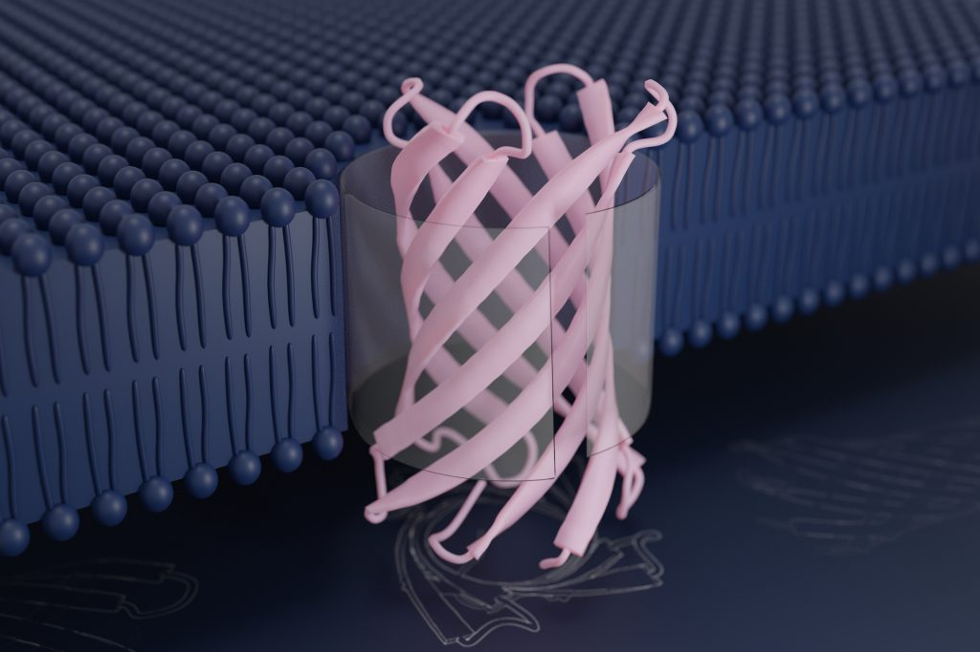
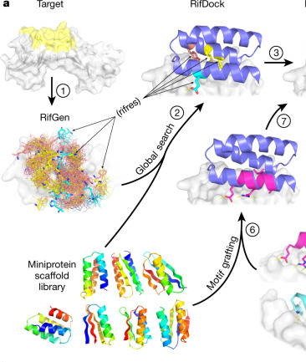
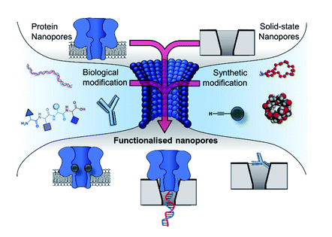
A new nanopore platform
Thakur, 2019
Cao, 2022
Vorobieva, 2021
Caims-Gibson, 2021
11
Notes:
Similar to existing work
(+) Single molecule sensitivity
(+) Target analyte specificity
(-) Relies on existing protein-protein interactions
(-) Requires the use of a lipid bilayer membrane
Our collaboration with the IPD aims to accomplish this with:
Customizable, de-novo nanopore proteins
Rapid development of de-novo minibinders
Use of durable, mass manufacturable solid-state membranes in a hybrid nanopore system

Slide 12
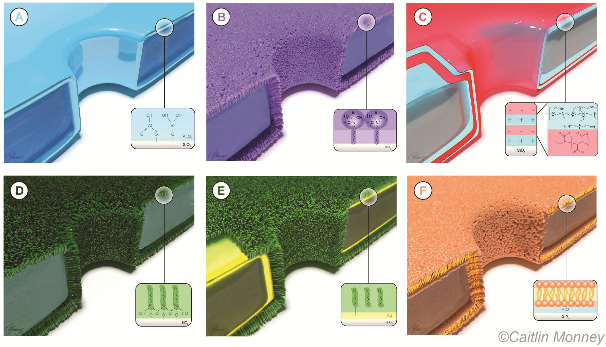
Nanopore surface coatings

Slide 13
Project #1: title card? This was actually project 2 in the thesis

Slide 14
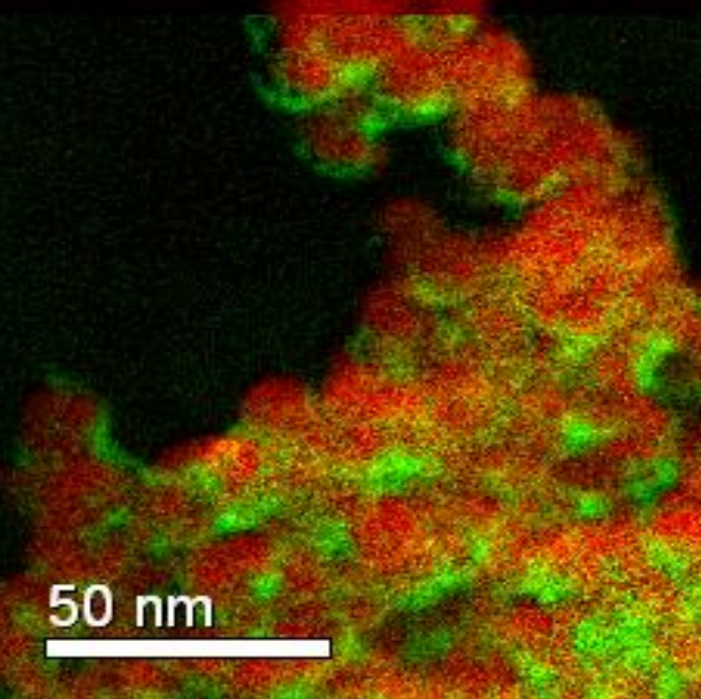

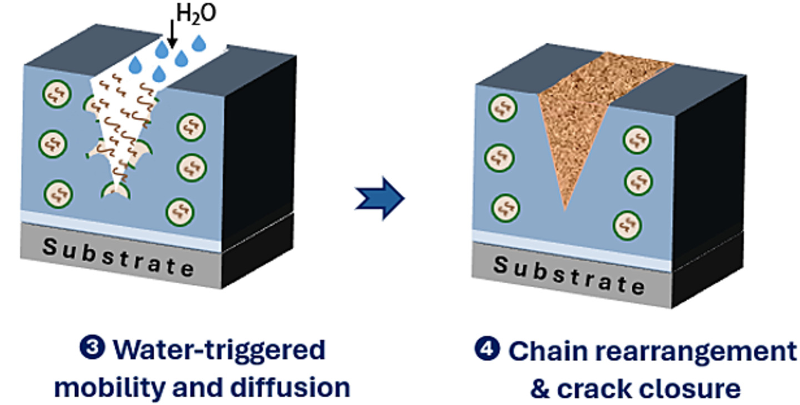
Polyurea
(Bullet Liner, 2026) [23]
(Mahtabani et al., 2023) [25]
(Avdeliodi et al., 2026) [24]
14

Slide 15
Molecular layer deposition
Purge excess
Purge excess
15
Notes:
Cyclic process
ALD results in a metal oxide film
HfO₂ will be used to reduce:
Electrical noise
Corrosion
Pore diameter

Slide 16
Polyurea MLD Chemistries
Aryl isocyanates are more reactive than alkyl isocyanates
Rigid backbone results in fewer double reactions and higher GPC
(Meng, 2017)²⁶

Slide 17
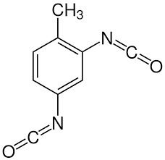
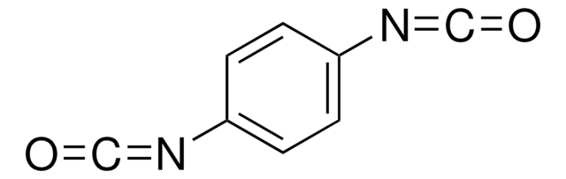
TDIC vs PDIC
1,4-phenylene diisocyanate (PDIC)
2,4-toluene diisocyanate (TDIC)
Melting point: 100°C
Melting point: 21°C
17
17

Slide 18
Slide explaining SE

Slide 19
TDIC & ED Growth Characteristics
GPC depends heavily on ED purge time
GPC does not depend on TDIC purge time (soft saturation)
Linear relationship between cycles and thickness

Slide 20
Soft saturation
Ideal monolayer growth, with some “double reactions”, and diffusion into the subsurface
Subsurface groups migrate to surface, taking the place of DRs AKA “termination-diffusion”
Excess precursor diffuses to surface and participates in additional reactions, causing “soft saturation”
Figure 5. An animated diagram of the MLD process
20
20

Slide 21
Slide explaining FTIR

Slide 22
TDIC & ED FTIR

Slide 23
X-ray photoelectron spectroscopy (XPS)
XPS is consistent with TDIC / ED polyurea
C 1s spectrum is fit with a 4-peak model

Slide 24
TDIC XPS Model
3-peak model
4-peak model

Slide 25



Streaming potential
Surface (-)
$$ζ=−\frac{\left\langle σ_{e}\right\rangle μΔφ_{sp}}{ε_{e}Δp}$$
$$p_{1}$$
$$p_{2}$$
Surface (-)
+
+
+
+
+
+
+
+
+
+
Surface (-)

Slide 26
WCA & UVO methods and data

Slide 27
Rebound experiment method and data

Slide 28
Amine group availability method and data

Slide 29
Degradation pathway proposal (Kuang)

Slide 30
Project #2: SNP coating
SNPs have been coated with a variety of thin films
TDIC & ED Polyurea: diameter control, but not positively charged
SAM: nominally no diameter control, exerpimentally uncontrolled polymerization
ALD: diameter control and charge control (ICR). Unsuccessful phosphonate SAM coatings concept and prospective

Slide 31
TDIC & ED Polyurea SNP coatings
TDIC & ED PU has been deposited on solid state nanopores. This was successful in the sense that it created coated nanopores with reduced pore diameter
The surface charge was negative in most cases
This is because of hydrophobic-water interfaces

Slide 32
Conductance experiments
Apply a potential across a silicon nitride nanopore in an electrolyte with high ionic strength
Resulting potential drop can be converted to ion current / solution resistance
Assume the potential drop in the reservoir is negligible
The diameter of the pore and the sign of the surface charge (positive, negative, or neutral) can be determined from a simple set of experiments
Notes:
This equation is widely used for calculating nanopore diameter from the conductance of the pore given the conductivity of the solution and geometry of the pore.
People usually use bulk conductivity to calculate diameter, which omits surface conductance. For small charged pores, this can be significant. In a 5x30nm pore, at an ionic strength of 1M, 12% of the cross sectional length, 22% of the area, and 22% of the volume resides in within 1λ of the wall.
Total: r=2.5, h=30, A=19.6 nm^2, V=590 nm^3
Minus debye: r=2.2, h=30, A=15.2nm^2, V=456nm^3

Slide 33

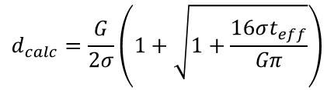
Conductance-based diameter calculation
$$d_{calc}=\frac{G}{2σ}\left(1+\sqrt{1+\frac{16σt_{eff}}{Gπ}}\right)$$
$$where G=\frac{1}{R}=\frac{I}{V}$$

Slide 34






Ion current rectification: geometric asymmetry
+
Cation exclusion
x
$$\left|J_{−,E}\right|$$
$$\left|J_{+,E}\right|$$
+
+
+
Cation enrichment
Forces equivalent anion enrichment
+
+
Surface (-)
Cation exclusion
x
34
-
Notes:
“At the narrow end of the pore, the electrical double layers overlap. Because the surface is negatively charged, this region contains an excess of cations and is therefore cation-selective.
Under an applied electric field, cations and anions migrate in opposite directions. But because there are more cations than anions in the constriction, the magnitude of the cation electromigration flux is larger than the anion electromigration flux.
With the negative electrode on the constricted side, this imbalance produces a net ion-number flux into the constriction. The resulting accumulation cannot consist indefinitely of excess positive charge, so the concentration profile adjusts and anions are enriched as well.
The result is net salt enrichment in the pore. Since conductivity depends on the total mobile-ion concentration, the enriched pore has lower resistance and this is the high-current state.”

Slide 35




Ion current rectification
+
$$\left|J_{−,E}\right|$$
$$\left|J_{+,E}\right|$$
+
+
+
Cation depletion
Forces equivalent anion depletion
+
+
Surface (-)
35
-
Notes:
“When the voltage is reversed, the EDL does not change its selectivity. The constriction still contains more cations than anions, so the cation electromigration flux is still larger in magnitude than the anion flux.
What changes is the direction of that flux imbalance. Now the larger cation flux is directed away from the constricted region. This produces a net loss of mobile ions from the constriction.
Again, we cannot sustain large-scale charge separation, so anion concentration decreases along with the cation concentration. The constriction remains cation-rich relative to anions because it must still screen the negative surface, but the total concentration of mobile ions decreases.
This produces a salt-depleted, high-resistance region and therefore the low-current state.”

Slide 36
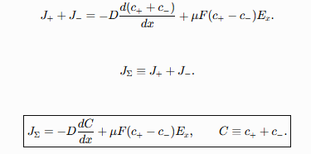




Ion current rectification
+
+
$$\left|J_{−,E}\right|$$
$$\left|J_{+,E}\right|$$
+
+
+
Cation enrichment
Forces equivalent anion enrichment
+
+
Surface (-)
$$\left|J_{−,E}\right|$$
$$\left|J_{+,E}\right|$$
+
+
+
Cation depletion
Forces equivalent anion depletion
+
+
Surface (-)
-
-
Notes:
“When the voltage is reversed, the EDL does not change its selectivity. The constriction still contains more cations than anions, so the cation electromigration flux is still larger in magnitude than the anion flux.
What changes is the direction of that flux imbalance. Now the larger cation flux is directed away from the constricted region. This produces a net loss of mobile ions from the constriction.
Again, we cannot sustain large-scale charge separation, so anion concentration decreases along with the cation concentration. The constriction remains cation-rich relative to anions because it must still screen the negative surface, but the total concentration of mobile ions decreases.
This produces a salt-depleted, high-resistance region and therefore the low-current state.”

Slide 37
Ion current rectification
+
+
Anion migration
✔
-
+
+
+
-
+
+
+
+
+
+
+
+
+
+
+
+
Cation exclusion
-
-
-
+
-
x
+
+
-
-
+
+
-
-
-
+
EDL (+)
+
+
+
+
+
+
+
+
+
+
-
-
-
+
-
Surface (-)
-
+
+
Preferential cation direction
High C
+
+
+
Low C
-
+
+
+
+
+
+
+
+
+
+
+
Anion exclusion
+
+
+
+
Anion migration
-
-
-
-
-
x
✔
EDL (+)
+
+
+
+
-
+
+
+
+
+
+
+
+
+
+
-
Surface (-)
+
+
-
-
37
-
-
Notes:
Solid state nanopores may be 15±3nm, while SAM changes diameter by ~1.5nm
Diameter can be measured via conductance before and after treatment by drying with critical point drying (CPD) between measurements
Surface charge can be measured via ion current rectification (ICR)

Slide 38
Diameter and charge (sign) of PU coated NPs

Slide 39
Hybrid nanopore method and data

Slide 40
DNP Silane coatings
DNPs have been coated with silanes, which are difficult to control and produce negatively charged films even with amine functionality
Polymerization occurs even with cyclic silanes like DMTSCP
Characterizing coating properties / thickness is very difficult and time consuming

Slide 41
Slide explaining normal and cyclic silane deposition

Slide 42
Silane coated pores change in diameter and charge sign data

Slide 43
Slide explaining silane polymerization

Slide 44
Slide introducing ALD and hafnium oxide

Slide 45
Slide showing hafnium oxide deposition temperature dependence

Slide 46
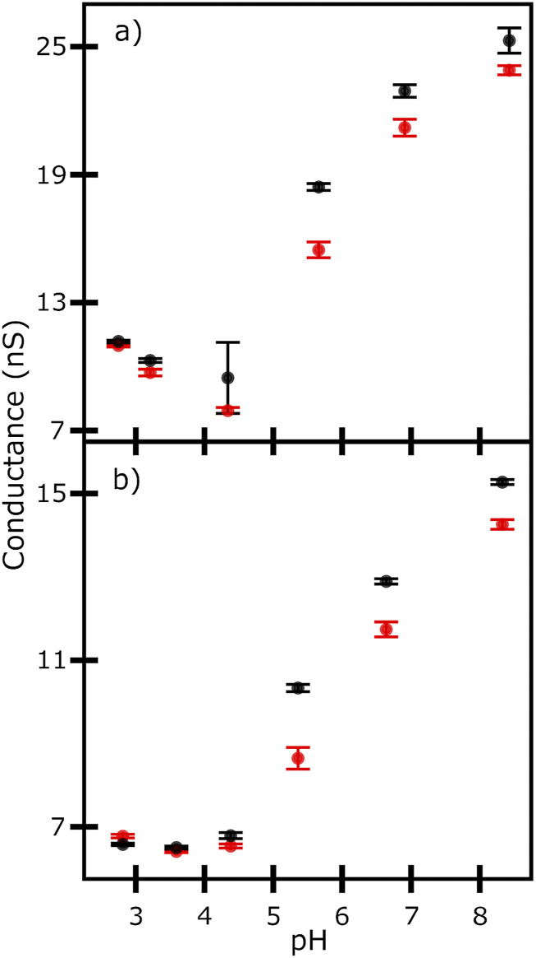
Slide showing hafnium oxide coated SNP ICR / charge sign vs pH

Slide 47
Slide showing phosphonate SAM concept

Slide 48
Slide introducing cationic MLD
Review the need for cationic MLD

Slide 49
Slide introducing quaternization
Quaternization with MeI
VP quaternization examples
Zeta potential examples

Slide 50
Slide introducing TAEA + TDIC and DAMDPA + TDIC chemistry

Slide 51
Slide(s) showing DAMDPA + TDIC XPS results

Slide 52
Slide introducing EIS?

Slide 53
Future work slide(s)

Slide 54
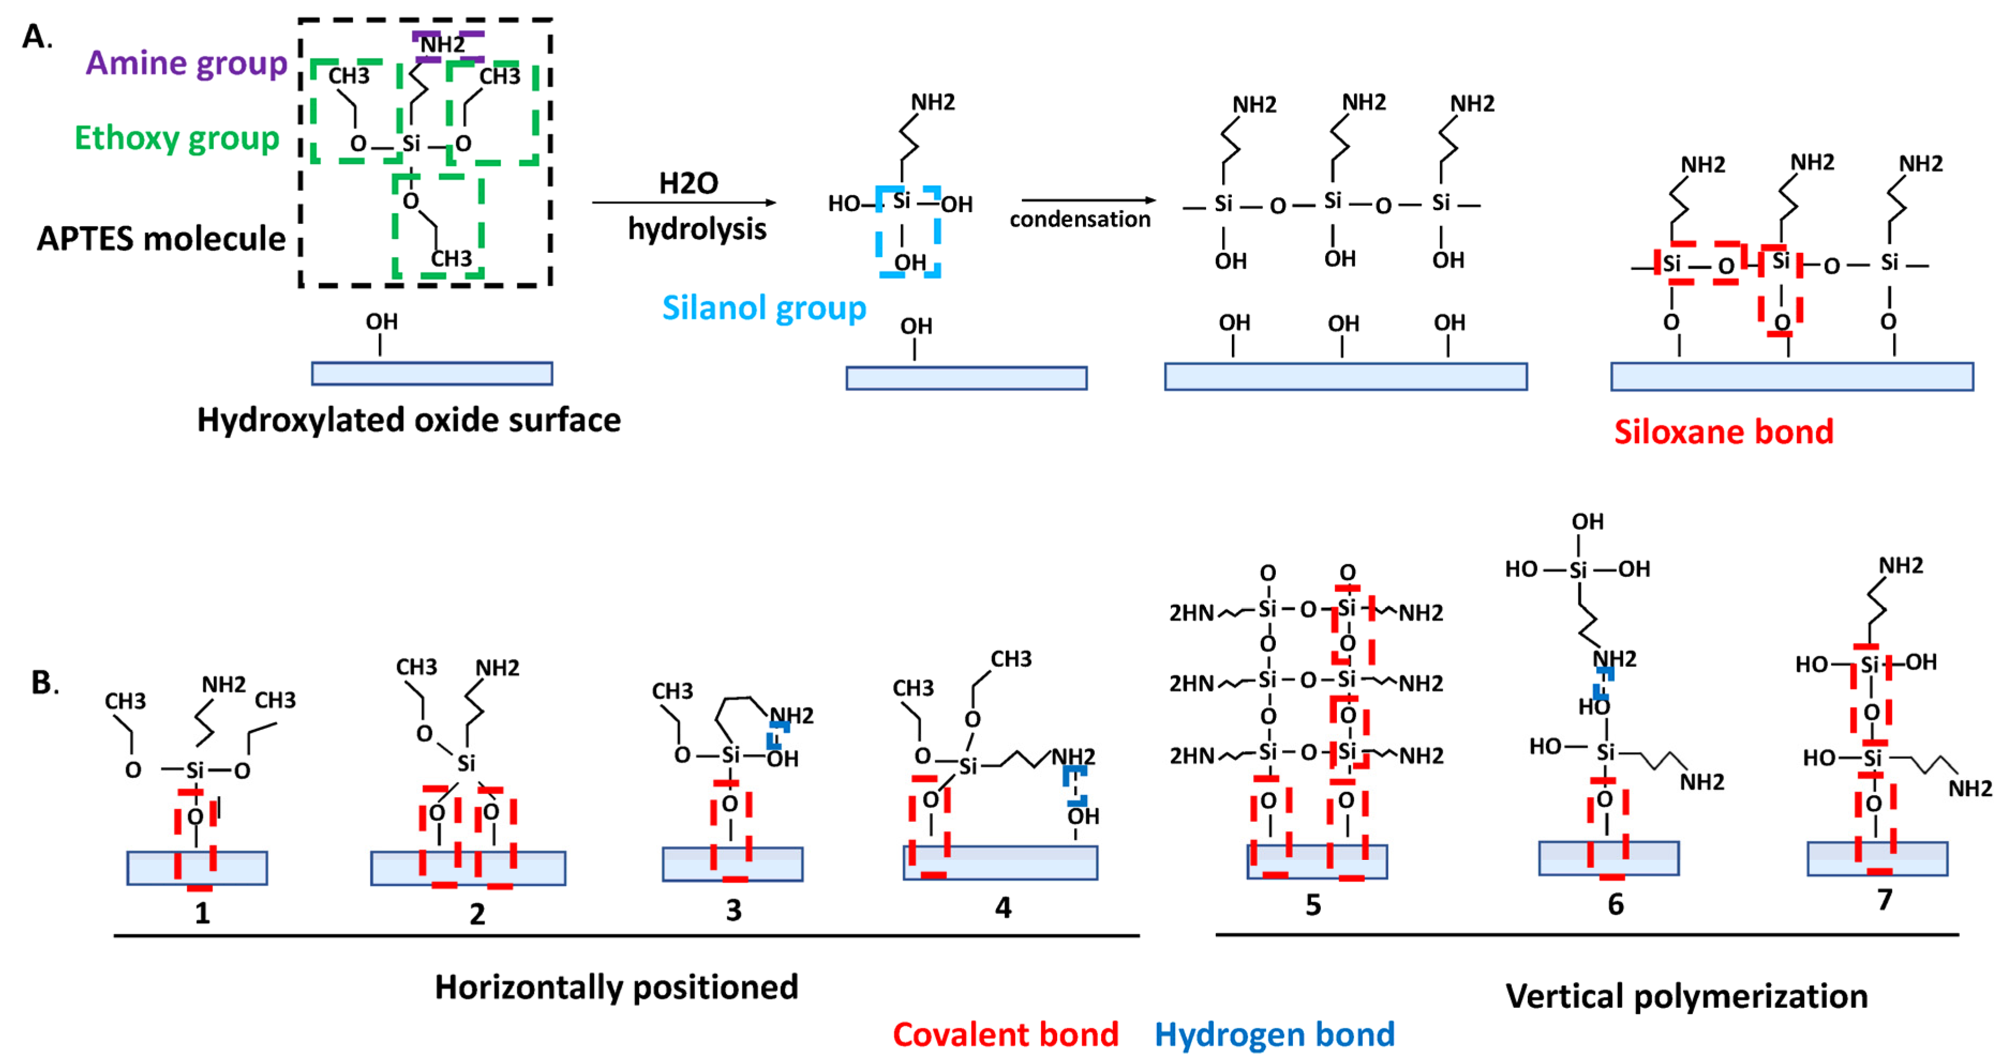
Self Assembled Monolayers (SAMs)
54
Notes:
Single layer deposition (ideally)
SAMs will be used to:
Set surface charge
Provide organic functionality for crosslinking

Slide 55
a)
b)
c)
d)
55

Slide 56
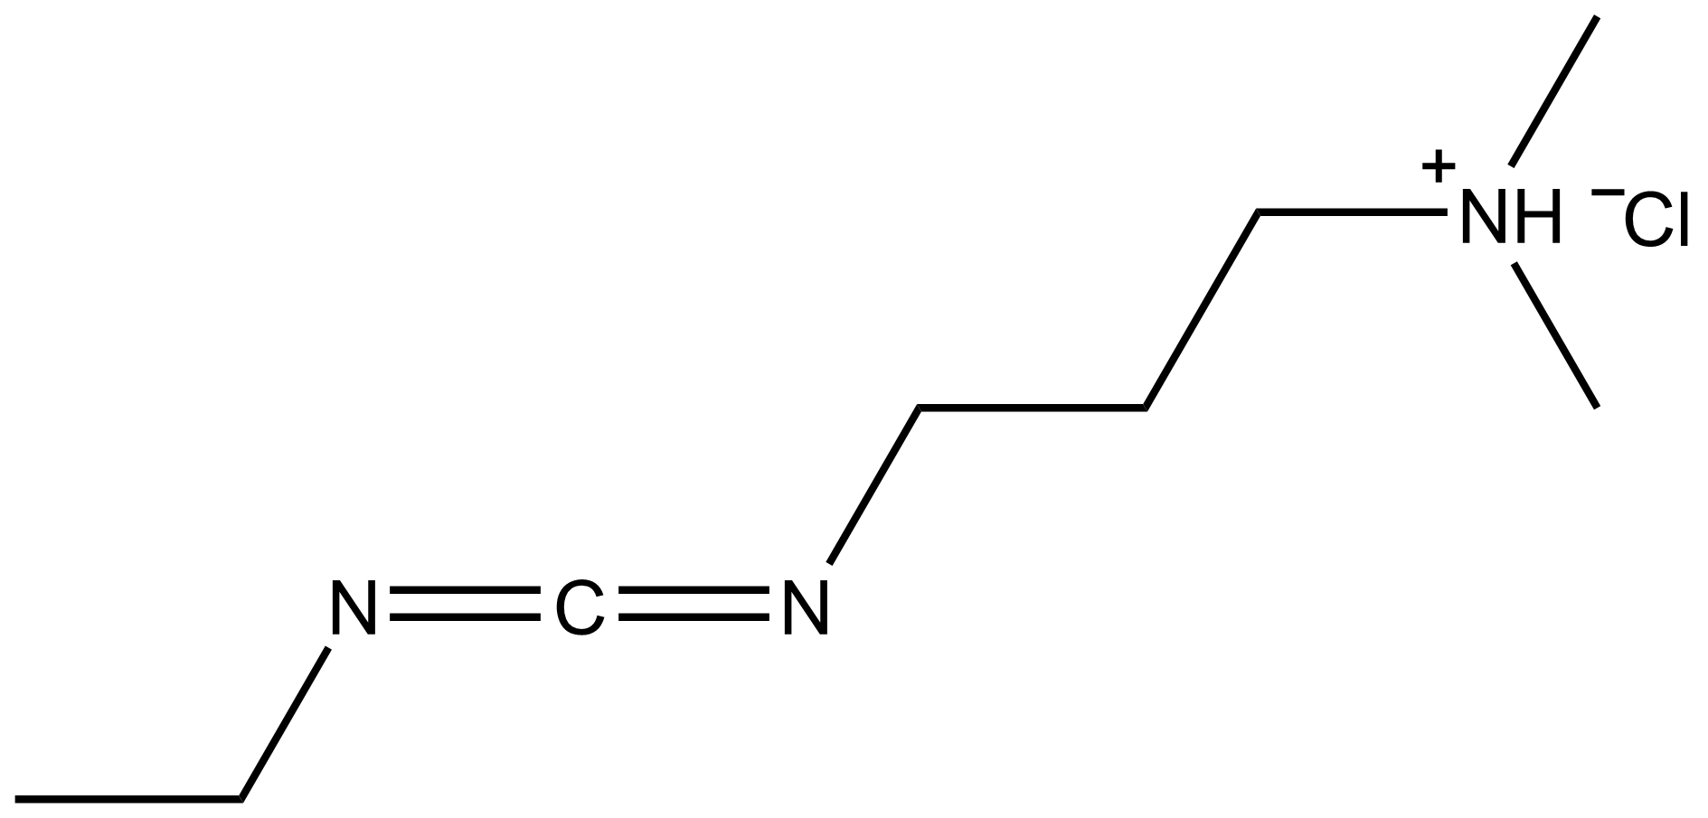
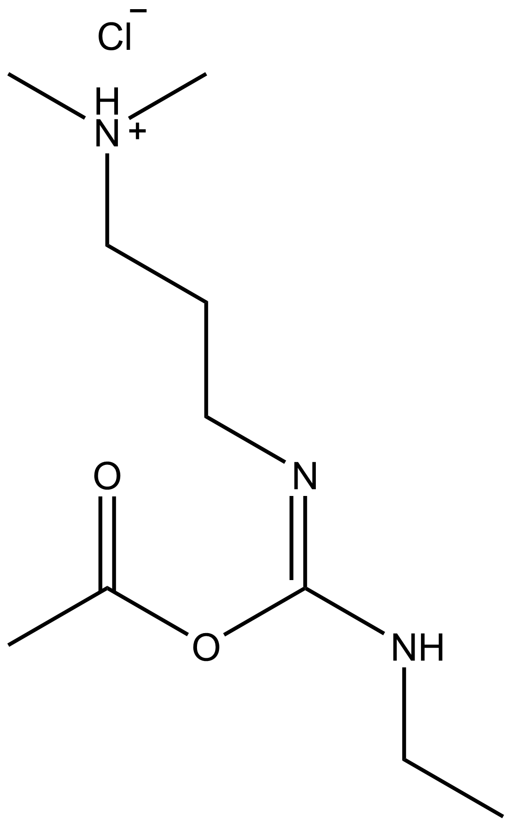
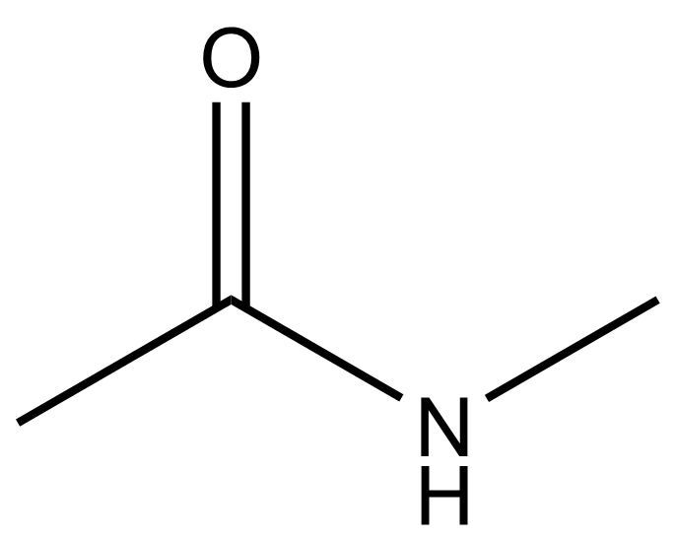
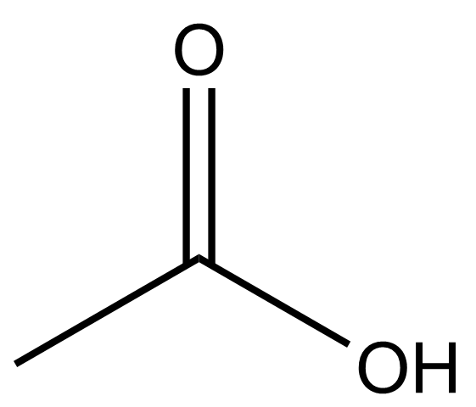
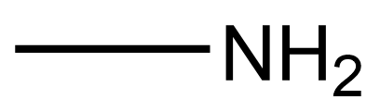
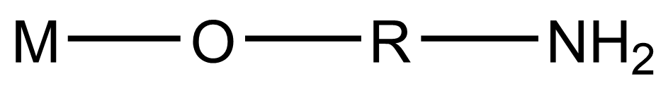

Slide 57
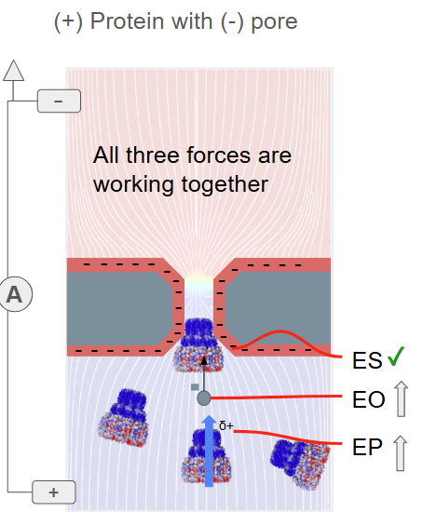
Hybrid nanopores
Our system is constructed with:
An overall positively charged protein
Dipole moment pointed “down”
Necessitates a negative solid-state surface charge
+
δ+
57

Slide 58
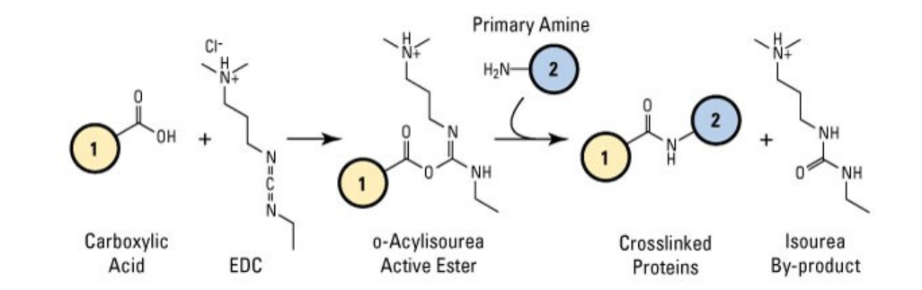
Application requirements
58
Notes:
Negatively charged surface to facilitate cooperation of electrokinetic effects with a positively charged protein
Surface functional groups to facilitate covalent crosslinking

Slide 59
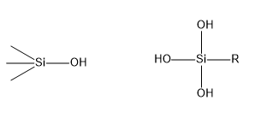
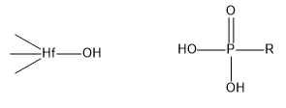
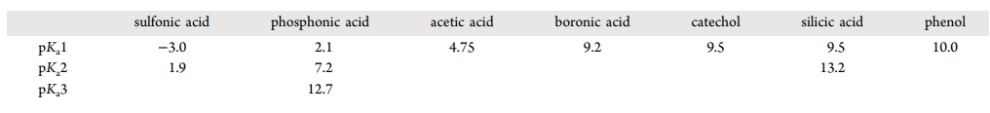
Acid condensation SAMs
pKa = 8.0
pKa = 6.0
pKa = 9.5
pKa = 2.1
Increasing metal oxide acidity
BaO < MgO < HfO2 < ZnO < Al2O3 < TiO2 < In2O3 < SnO2 < NiO2 < SiO2.
Increasing anchor group acidity
(Li, 2024) https://doi.org/10.1021/acs.chemrev.3c00396
59
Notes:
Acid-base reaction with M-OH
Bond strength -> relative acidity / basicity
(must both be weak acid / base)
Silanes work for silicon, phosphonates work for hafnium
Silanes can polymerize (homocondensation: surface metal atoms are the same as SAM metal atom)

Slide 60
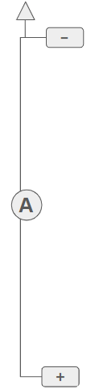
Verification of SAM on pore surface
Reduced ionic flux
Improved ionic flux
$$d_{calc}=\frac{G}{2σ}\left(1+\sqrt{1+\frac{16σt_{eff}}{Gπ}}\right)$$
High c
High c
$$where G=\frac{1}{R}=\frac{I}{V}$$
x
+
-
+
-
+
-
+
-
+
-
+
-
+
-
+
-
+
-
+
-
+
-
+
-
+
-
+
-
+
-
+
-
+
-
+
-
+
-
+
-
+
-
+
-
+
-
+
-
+
-
+
-
+
-
+
-
+
-
+
-
+
-
+
-
+
-
+
-
+
-
+
-
+
-
+
-
+
-
+
-
+
$$j_{i}\left(r\right)=−D_{i}\frac{∂c_{i}\left(x,r\right)}{∂x}−z_{i}c_{i}\left(x,r\right)D_{i}\frac{F}{RT}\frac{∂φ\left(x,r\right)}{∂x}+c_{i}(x,r)j_{v}(r)$$
-
+
-
+
-
+
-
+
-
+
-
+
-
+
-
+
x
+
Low c
Low c
60
Notes:
Solid state nanopores may be 15±3nm, while SAM changes diameter by ~1.5nm
Diameter can be measured via conductance before and after treatment by drying with critical point drying (CPD) between measurements
Surface charge can be measured via ion current rectification (ICR)

Slide 61
Surface charge from ICR
The following are ICR plots which show the change in surface charge with coating
61

Slide 62
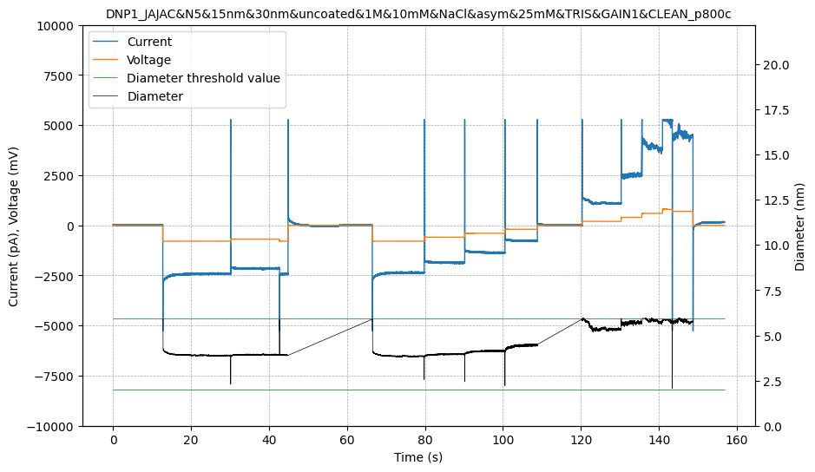
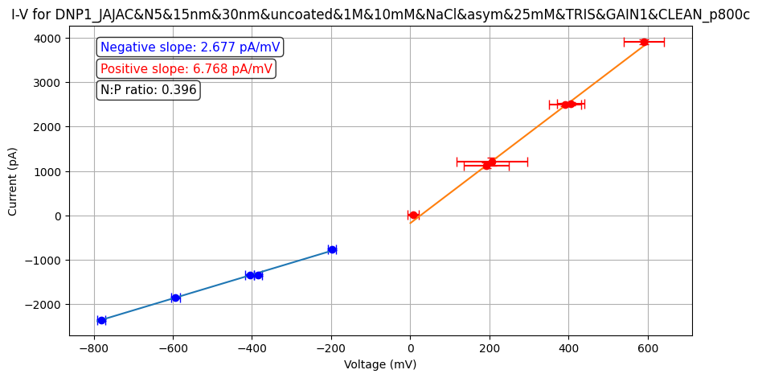
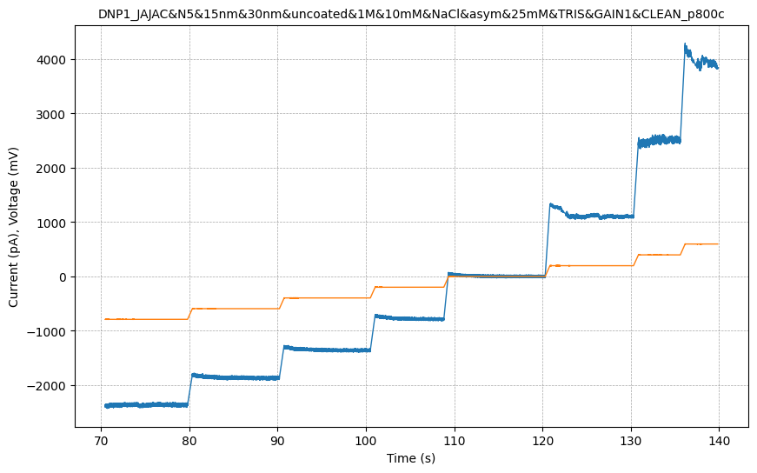
DNP1_JAJAC&N5&15nm&30nm&uncoated&1M&10mM&NaCl&asym&25mM&TRIS&GAIN1&CLEAN_p800c
Uncoated 15nm pore
Asymmetric salt
Collected 4/11/25
62

Slide 63
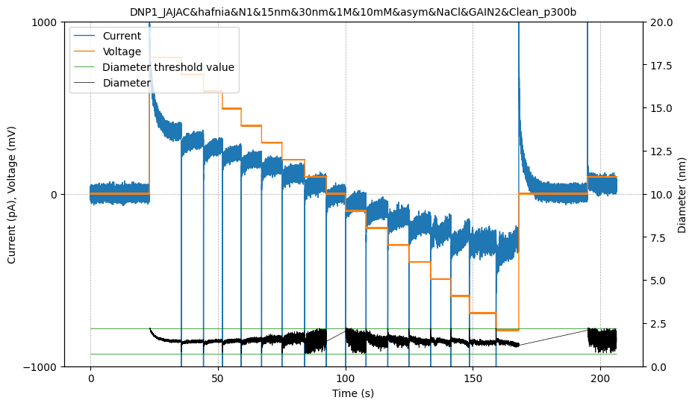
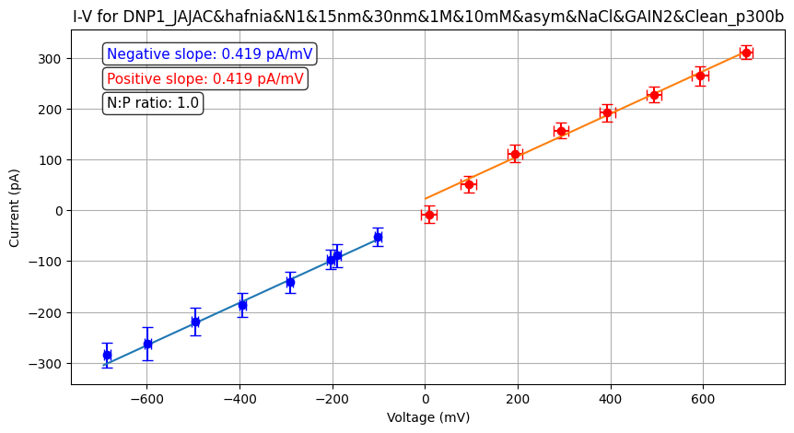
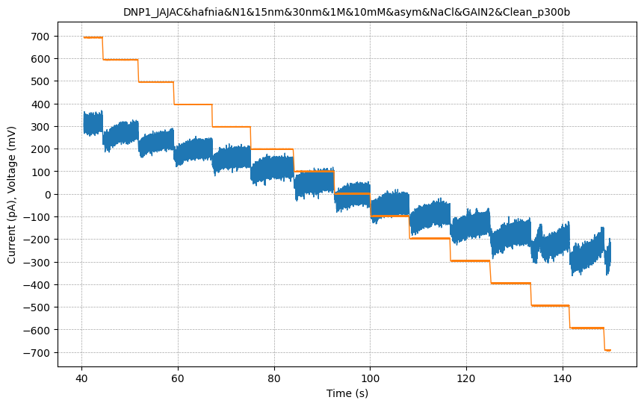
DNP1_JAJAC&hafnia&N1&15nm&30nm&1M&10mM&asym&NaCl&GAIN2&Clean_p300b
Hafnia coated 15nm pore
Collected 6/12/25
63

Slide 64
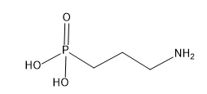
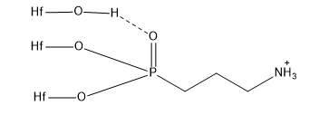



DNP1_JAJAC&hafnia&N2&15nm&30nm&1M&1M&NaCl&3APA&RSR&DMSO&GAIN2&Clean_p100a
Hafnia coated 15nm pore
Coated with 3-APA
Collected 6/13/25
7.64 nm
64

Slide 65





DNP1_JAJAC&CrossL&Hafnium&5nmGrowth&3PPA&N1&rep2&15nm&30nm&1M&10mM&asym&NaCl&ph8&TRIS&Gain2&Clean_p800b
Hafnia coated 15nm pore
Coated with 3-PPA
Collected 7/7/25
65

Slide 66
Calculate diameter from conductance?
Maybe

Slide 67



Calculation of diameter via conductance
$$d_{calc}=\frac{G}{2σ}\left(1+\sqrt{1+\frac{16σt_{eff}}{Gπ}}\right)$$
$$where G=\frac{1}{R}=\frac{I}{V}$$
Treated decrease of >10nm
?
Treated decrease of ~2nm
Untreated decrease of <1 nm
67

Slide 68


Slide 69



Silanes vs phosphonates
Silanes polymerize. Phosphonates do not
Silane is sensitive to slight excesses of water
Phosphonates are tolerant of water
Phosphonates are more stable when combined with weakly acidic metal oxides
3-Aminopropylphosphonic acid
69

Slide 70


Charge properties of ALD coated nanopores
ALD results in metal oxide surfaces
Ionizable groups on the surface
Charge = average density of [+] and [-], dependent on pH
Different groups have different equilibrium constants
Characterized by the “isoelectric point”
  For a single group surface, this is the average pKa
70

Slide 71
TDIC & ED Polyurea
Ideal MLD linear relationship between cycle and thickness
Growth per cycle (GPC ) is exponentially related to dose
Ideal, exponential saturation of ED
Soft saturation of TDIC due to excess precursor participating in additional reactions
High doses of ED break exponential curve, but recover with additional purging
Confirmed with FTIR and XPS analysis
Figure 4: a) film thickness vs cycle count, giving GPC, b) saturation curve of ED, c) saturation curve of TDIC.
Open circles: 1800s purging
71
71

Slide 72

Polyurea deposition of TDIC or PDIC & ED
Polyurea from polyisocyanate such as toluene diisocyanate (TDIC) or phenylene diisocyanate (PDIC) plus polyamine such as ethylene diamine (ED)
Similar growth characteristics, but different GPC
Bond angle difference between precursors
GPC: 4.1A/cycle
TDIC & ED (this work)
PDIC & ED (Loscutoff, 2010)
GPC: 1.8A/cycle
72

Slide 73


Application requirements
Polyurea shows a negative zeta potential
Polyurea coated silica was crosslinked with fluorescein isothiocyanate
UVO exposure eliminates polyurea, but not APTES
UVO reduces water contact angle from 70 degrees to 20 degrees
73

Slide 74

Positively charged pore?
Designing negatively charged proteins is easier
Getting positively charged solid state surface is harder
Al2O3 and HfO2 IEP: 8-9
Short chain SAMs can take on a net positive charge while polymers are almost always negative
Short chain SAMs may have less noise due to configurational switching
NH₃
74

Slide 75
Conclusion
Hybrid nanopores are an attractive alternative to immunoassays in the diagnostics laboratory than can give greater control over the assay at a lower cost
The hybrid nanopore structure requires a surface coating, such as with MLD
2,4-toluene diisocyanate is a favorable alternative to 1,4-phenylene diisocyanate for polyurea MLD processes because of its melting point and ubiquity in industry
The growth characteristics are as expected, with an observation of soft saturation of TDIC, although with an overall lower GPC than PDIC
FTIR and XPS data are consistent with polyurea films
Fluorescence tagging shows the presence of amine functionality on the surface
Negative zeta potential at neutral pH is compatible with the chosen positively charged proteins
75
75

Slide 76

Future work
Polyurea coated nanopores are more difficult to wet than uncoated nanopores
Water contact angle (WCA) is a measure of the wettability of a surface (uncoated silicon: <5˚, coated: ~70˚). Can be reduced with UVO
3-(aminopropyl)triethoxysilane coated silica treated with UV-ozone (UVO) and crosslinked with FITC shows no reduction in surface amine
Will conduct experiment using polyurea coated silica or, ideally, polyurea coated silicon / fused silica wafers
76
76

Slide 77

Future work
Kuang et al show that UVO decreases WCA of polyurethane
This accompanied by a decrease in aliphatic/carbonyl and aliphatic/carbon-oxygen bond ratios and an increase in surface roughness
Upon washing, the bond ratios partially recover, as does the WCA (WCA 70˚->18˚->48˚)
Surface roughness fully recovers (rms 0.392->2.072->0.321 nm)
This indicates that the film was cleaved at a uniform depth and the polymer fragments on the surface were responsible for the WCA reduction
Replicate this experiment with polyurea and add surface functionality assessment
 | C-C / C=O | C-C / C-O | C=O / C-O
Untreated | 3.6 | 5.4 | 1.5
UVO treated | 1.6 | 3.0 | 1.8
UVO treated, then washed | 2.4 | 3.7 | 1.5
77

Slide 78





Acknowledgements
The Bill and Melinda Gates Foundation
The Institute for Protein Design
The Nanopore Biophysics Group
The Molecular Analysis Facility
The Washington Clean Energy Testbeds
The Bergsman Research Group
The MJ Murdock Diagnostics Foundry for Translational Research

Slide 79
References
^{[1]} https://www.rapidnovor.com/what-is-protein-mass-spectrometry/
^{[2]} https://www.agilent.com/en/solutions/cell-analysis/molecular-biology-biochemical/enzyme-linked-immunosorbent-assay-elisa
^{[3]} asdf

Slide 80

Zeta potential of hydrophobic interfaces
Oft re-discovered phenomenon
All hydrophobic interfaces exhibit an acidic IEP
Alternating charge due to water structure
Results in relatively large free energy of adsorption and saturation coverage of OH⁻
O-H⁻
Density of species
Density of charge
O-H⁻
Species | ΔG (Kj/mol) | Saturation coverage
OH⁻ | -45 | 1.00
Cl⁻ | -40 | 0.20
H⁺ | -28 | 0.31
10.1021/ja044426f
10.1073pnas.0901480106
80

Slide 81
Purging
ED is sensitive to purging
Insufficient purging can result in erroneous saturation behavior
81

Slide 82

FTIR
2933cm⁻¹ & 2873cm⁻¹: aliphatic CH₂ stretching
2275cm⁻¹ residual isocyanate
1667cm⁻¹ & 1557cm⁻¹: Amide I & II peaks
3358cm⁻¹: N-H stretch
Figure 6. FTIR spectrum of the TDIC-ED polyurea film
82

Slide 83

XPS
7:2:1 C/N/O observed
5.5:2:1 C/N/O theoretical
No silicon (eg SiO₂) peak observed
3:3:1 aliphatic/aromatic/carbonyl observed
1.5:3:1 theoretical
O 1s shoulder attributed to a shakeup
XPS data of the TDIC-ED polyurea film. a) survey scan, b) fine scan of carbon, c) fine scan of oxygen, d) fine scan of nitrogen
83

Slide 84

Antibody’s secret sauce
Highly specific protein-protein interactions (PPIs) between paratope and epitope
PPIs are the central phenomenon that makes antibody testing so powerful
84

Slide 85




Surface coatings for a positively charged protein
What do we want the coating to do?
Provide a negatively charged surface
Change the pore diameter
Prevent erosion of the solid state nanopore
Provide functionality for covalent bonding to the protein nanopore
What are our options?
Do nothing (work with the default SiN)
ALD of titanium oxide or halfnium oxide
MLD of 2,4-toluene diisocyante and ethylene diamine
Pros: | Cons:
-Requires no additional labor -Negatively charged | -No control over pore diameter (manufacturer spec +/-3nm) -Will erode in electrolyte -No (organic) functionality to crosslink
Pros: | Cons:
-Well documented in literature -Negatively charged -Resistant to corrosion -Control over pore diameter | -No (organic) functionality to crosslink to
Pros: | Cons:
-Negatively charged -May be resistant to corrosion -Control over pore diameter -Customizable functionality to crosslink to -Polyurea MLD is well documented | -Novel chemistry (a pro in terms of publication)
85

Slide 86

Real-time measurement of protein–protein interactions at single-molecule resolution using a biological nanopore
https://doi.org/10.1038%2Fnbt.4316
86

Slide 87
Best of all worlds
A collaboration between The Institute for Protein Design, the Nanopore Physics Group, and the Bergsman Research Group
De-novo nanopore design | De-novo binder design | Solid state support
Create durable, predictable, and self-assembling nanopores for the modular application of protein binders | Create durable, highly specific binders in a rapid development pipeline suited for mass production | Provide a durable, static support layer for the pores for their incorporation into diagnostic devices
1: https://doi.org/10.1126/science.abc8182
2: https://doi.org/10.1038/s41586-022-04654-9
3: https://doi.org/10.1039/D1SC05766A
87
Notes:
1: https://doi.org/10.1126/science.abc8182
2: https://doi.org/10.1038/s41586-022-04654-9
3: https://doi.org/10.1039/D1SC05766A

